Slide 1
Associating Education and Ethnicity With Water Insecurity
Atharva Naik

Slide 2
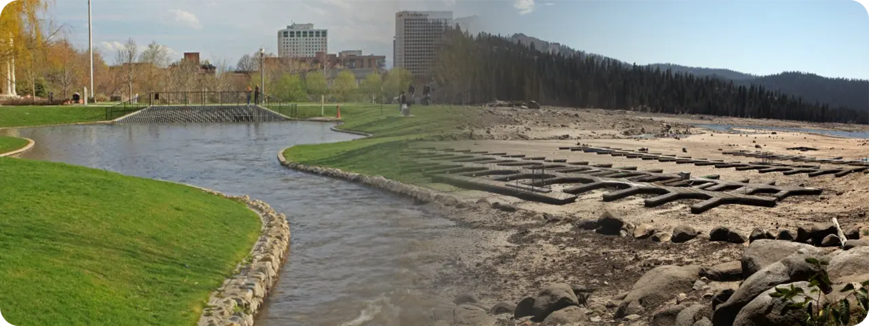
Figures adapted from U.S. Geological Survey, “Unequal access to water” (Public Domain)
Notes:
Change picture

Slide 3
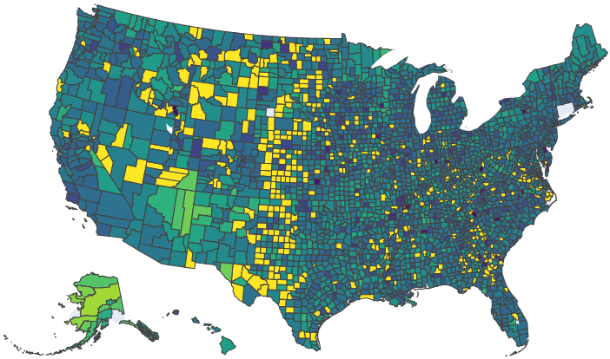
Water insecurity, visually
Brighter colors indicate a higher percentage of homeowners who lack plumbing and vice versa.

Slide 4
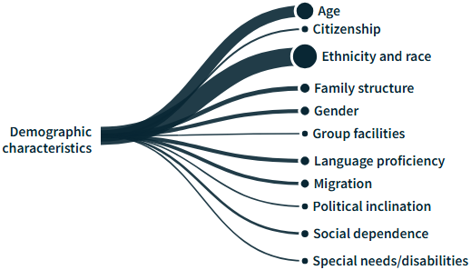
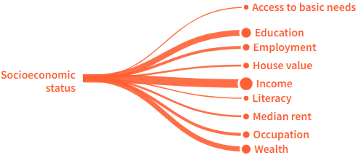
USGS “Unequal access to Water”
Identifies social vulnerability factors associated with water insecurity, but not the effects of interaction between multiple factors.
Figures adapted from U.S. Geological Survey, “Unequal Access to Water” (Public Domain)
Notes:
https://water.usgs.gov/vizlab/vulnerability-indicators/index.html#/en

Slide 5
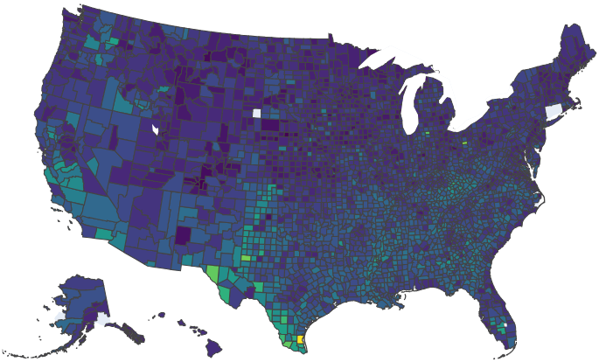
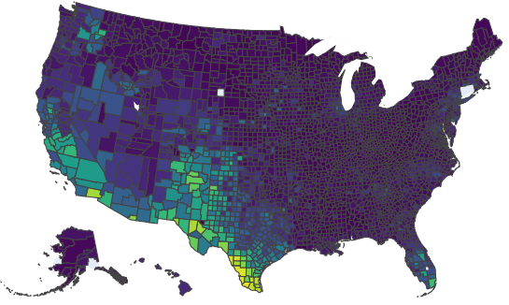
Education and Ethnicity
Proportion of county without high school education
Proportion of county that is Hispanic/Latino
To what extent is plumbing insecurity across U.S. counties
associated with educational attainment levels and ethnic composition?

Slide 6
Dataset & Variables
Using the 2019-2023 American Community Survey (ACS) 5-Year Estimates
geoid | Geographical identification tag
name | County name and state
plp | Percent of county homeowners lacking adequate plumbing
plp_scaled | plp log-scaled and standardized
hl_pct | Ethnic composition (Hispanic/Latino or not)
nhl_pct
below_hs_equivalent | Educational attainment levels
hs_equivalent
some_college
bachelor_above

Slide 7
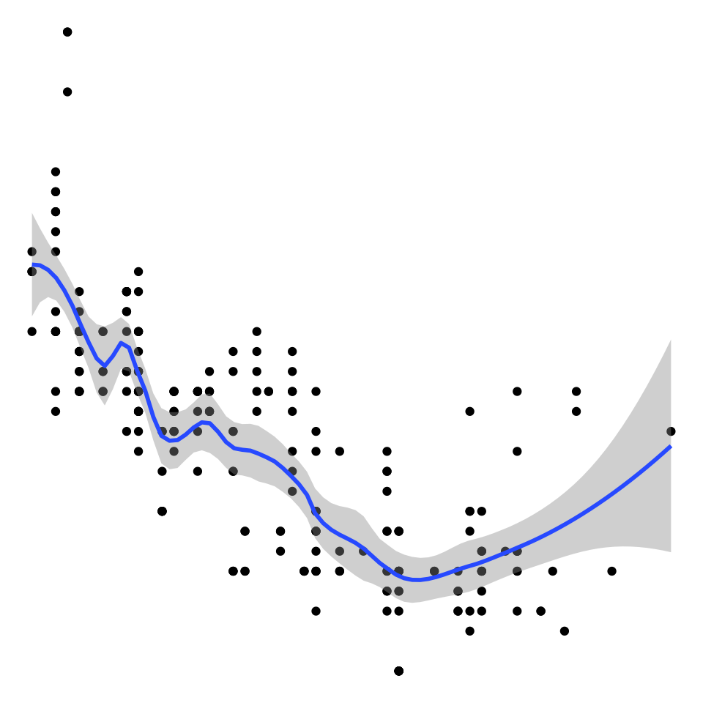
Generalized Additive Models (GAMs)
Smooth curves capture nonlinearity
Additive structure helps to interpret each feature/interaction’s effect
Figure adapted from Environmental Computing, “GAMs in R” (CC BY 4.0)
Notes:
https://environmentalcomputing.net/statistics/gams/

Slide 8
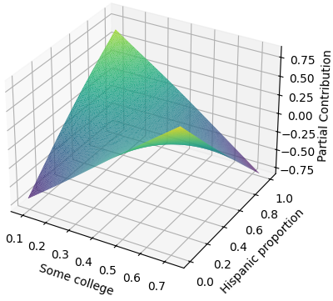
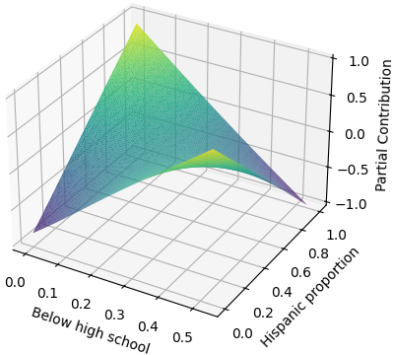
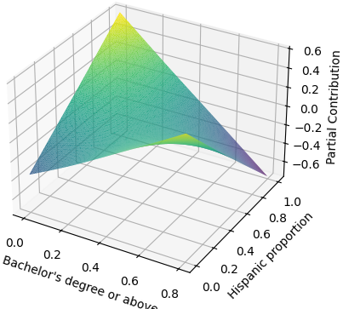
Interpreting Interactions Contribution
Interactions between features do contribute towards model performance.

Slide 9
Ablation Study
# | Description | R² | RMSE
1 | All education × Hispanic interactions | 0.0796 | 0.9589
2 | Removed Bachelor’s degree or above × Hispanic interaction | -0.0001 | +0.0001
3 | Removed some college × Hispanic interaction | -0.0001 | +0.0001
4 | Removed below high school × Hispanic interaction | -0.0012 | +0.0003
5 | Only below high school × Hispanic interaction | +0.0002 | -0.0001
6 | Only some college × Hispanic interaction | -0.0007 | +0.0004
7 | Only Bachelor’s degree or above × Hispanic interaction | +0.0001 | +0.0000
8 | No interactions | +0.0001 | +0.0000
N.S.D.
Education × Hispanic interactions do not meaningfully affect model performance, suggesting that their contribution to predicting plumbing insecurity is minimal.
Notes:
Highlight?
NSD

Slide 10
Takeaways
For prediction, interactions between education and ethnicity are less important than the social factors individually.
Next Steps
Analyze whether any combination of top social vulnerability factors (beyond education and ethnicity) is a strong predictor of plumbing insecurity.
Notes:
Education × Hispanic interactions do not meaningfully affect model performance, suggesting that their contribution to predicting plumbing insecurity is minimal.
Interactions between features do contribute towards model performance.
The combination of certain education levels and ethnic compositions does not strongly indicate higher plumbing insecurity rates.
Counties with both risk factors may not necessarily have higher plumbing insecurity rates than expected based on each factor individually.

Slide 11



Acknowledgements
The Coding School
Dr. Tara Flaugher, Ph.D.
Kayvan Jalali

